Slide 1


WEEK 10
SPRINT 4
PL6
REQ

Slide 2


about us.

Slide 3
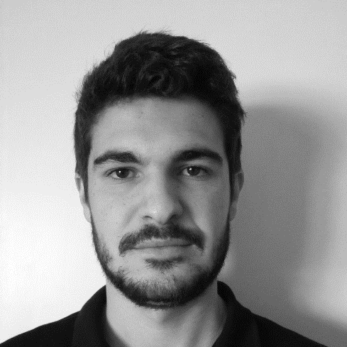
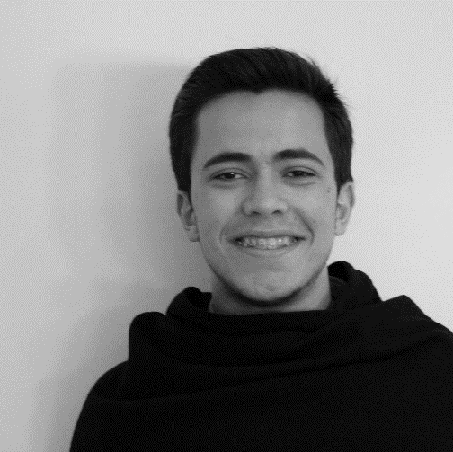
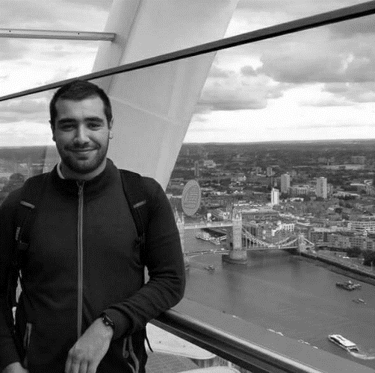

req.
Emanuel
Marco
Paulo
Nuno

Slide 4
tasks.
 | TASK #1 | TASK #2 | TASK #3
TASK | Finish Mockups Sprint 3 | Finish requirements document – Sprint 3 | Weekly presentation
OWNER | Nuno | Emanuel, Paulo | Marco
GOAL EFFORT | 2 H | 3 H 00 | 1 H
EFFECTIVE EFFORT | 2 H 30 | 4 H 00 | 0 H 40
STATUS | Not Completed | Not Completed | Completed

Slide 5
planned tasks.
 | TASK #1 | TASK #2 | TASK #3 | TASK #4
TASK | Update Mockups – Sprint4 | Update Requirements document - Sprint 4 | Meeting with implementation team | Weekly presentation
OWNER | Nuno | Emanuel, Marco Paulo | Team | Marco
GOAL EFFORT | 4 H 00 | 4H 00 | 2H | 1H
STATUS | Previous task | Previous task | NEW | NEW

Slide 6
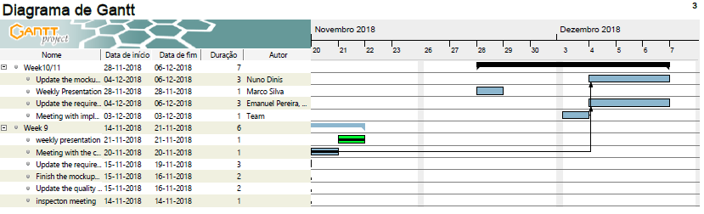
GANTT.

